Slide 1



Redis
Redis Key-Value Database:
Practical Introduction
SoftUni Team
Technical Trainers
Software University
http://softuni.bg

Slide 2


Table of Contents
What is Redis?
Installing and Running Redis
Redis Commands
String Commands
Working with Keys
Working with Hashes
Working with Lists
Working with Sets
Working with Sorted Sets

Slide 3

Redis
Ultra-Fast Data Structure Server

Slide 4
What is Redis?
Redis is:
Ultra-fast in-memory key-value data store
Powerful data structure server
Open-source software: http://redis.io
Redis stores data structures:
Strings, lists, hashes, sets, sorted sets
Publish / subscribe messaging

Slide 5

Redis: Features
Redis is really fast
Non-blocking I/O, single threaded
100,000+ read / writes per second
Redis is not a database
It complements your existing data storage layer
E.g. StackOverflow uses Redis for data caching
For small labs Redis may replace entirely the database
Trade performance for durability → data is persisted immediately

Slide 6
Installing Redis
To install Redis on Linux / Mac OS X:
Download from http://redis.io/download
Install it and run it
To install Redis on Windows:
Download https://github.com/MSOpenTech/redis
Compile the solution in the msvs folder and build it with VS
The easier way: use the Windows package manager Chocolatey
http://chocolatey.org
choco install redis

Slide 7
Running Redis
On Linux / Mac OS X start / stop the Redis service
The default Redis port is 6379 (the service name is redis_6379)
On Windows start / stop the "redis" service
Use the console-based (CLI) client or just connect with Telnet:
sudo service redis_6379 start
sudo service redis_6379 stop
sc start redis
sc stop redis
redis-cli
telnet localhost 6379

Slide 8
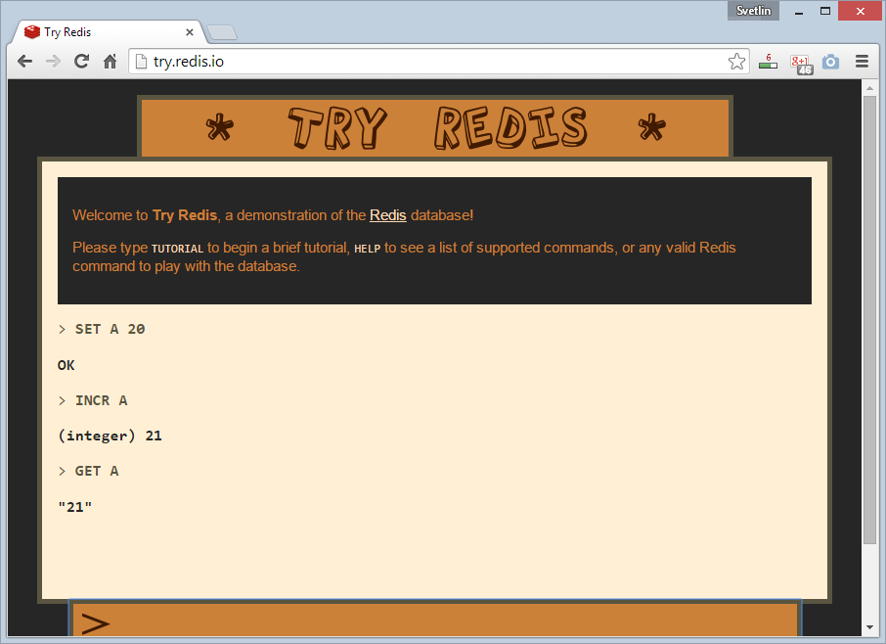
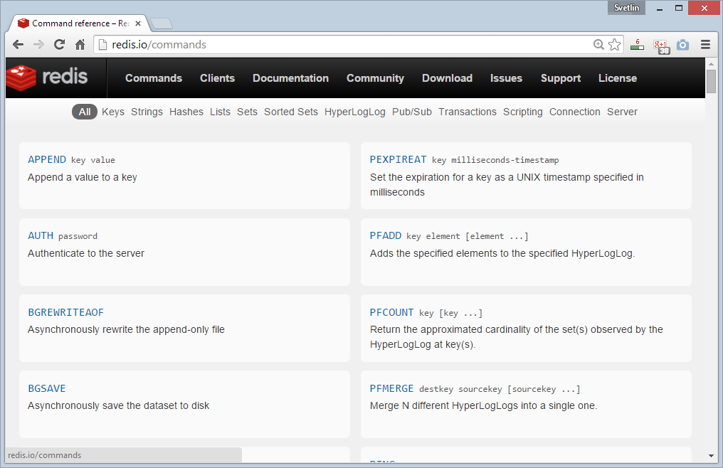
Redis: Basic Commands

Slide 9

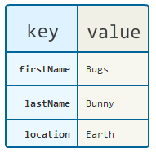
Redis: Data Model
Redis keeps key-value pairs
Every item is stored as key + value
Keys are unique identifiers
Values can be different data structures:
Strings (numbers are stored as strings)
Lists (of strings)
Hash tables: string → string
Sets / sorted sets (of strings)

Slide 10
Redis: Commands
Redis works as interpreter of commands:
SET name "Nakov"
OK
GET name
"Nakov"
DEL name
(integer) 1
GET name
(nil)
Play with the command-line client redis-cli
Or play with Redis online at http://try.redis.io

Slide 11
String Commands
SET [key] [value]
Assigns a string value in a key
GET [key] / MGET [keys]
Returns the value by key / keys
INCR [key] / DECR [key]
Increments / decrements a key
STRLEN [key]
Returns the length of a string
SET name "hi"
OK
GET name
"hi"
SET name abc
OK
GET "name"
"abc"
GET Name
(nil)
SET a 1234
OK
INCR a
(integer) 1235
GET a
"12345"
MGET a name
1) "1235"
2) "asdda"
STRLEN a
(integer) 4

Slide 12
Working with Keys
EXISTS [key]
Checks whether a key exists
TYPE [key]
Returns the type of a key
DEL [key]
Deletes a key
EXPIRE [key] [t]
Deletes a key after t seconds
SET count 5
OK
TYPE count
string
EXISTS count
(integer) 1
DEL count
(integer) 1
EXISTS count
(integer) 0
SET a 1234
OK
GET a
"1234"
EXPIRE a 5
(integer) 1
EXISTS a
(integer) 1
EXISTS a
(integer) 0

Slide 13
Working with Hashes (Hash Tables)
HSET [key] [field] [value]
Assigns a value for given field
HKEYS [key]
Returns the fields (keys) is in a hash
HGET [key] [field]
Returns a value by fields from a hash
HDEL [key] [field]
Deletes a fields from a hash
HSET user name "peter"
(integer) 1
HSET user age 23
(integer) 1
HKEYS user
1) "name"
2) "age"
HGET user age
"23"
HDEL user age
(integer) 1

Slide 14
Working with Lists
RPUSH / LPUSH [list] [value]
Appends / prepend an value to a list
LINDEX [list] [index]
Returns a value given index in a list
LLEN [list]
Returns the length of a list
LRANGE [list] [start] [count]
Returns a sub-list (range of values)
RPUSH names "peter"
(integer) 1
LPUSH names Nakov
(integer) 1
LINDEX names 0
"Nakov"
LLEN names
(integer) 2
LRANGE names 0 100
1) "Nakov"
2) "peter"

Slide 15
Working with Sets
SADD [set] [value]
Appends a value to a set
SMEMBERS [set]
Returns the values from a set
SREM [set] [value]
Deletes a value form a set
SCARD [set]
Returns the stack size (items count)
SADD users "peter"
(integer) 1
SADD users "peter"
(integer) 0
SADD users maria
(integer) 1
SMEMBERS users
1) "peter"
2) "maria"
SREM users maria
(integer) 1

Slide 16
Working with Sorted Sets
ZADD myzset 1 "one"
(integer) 1
ZADD myzset 1 "uno"
(integer) 1
ZADD myzset 2 "two" 3 "three"
(integer) 2
ZRANGE myzset 0 -1 WITHSCORES
1) "one"
2) "1"
…
Learn more at http://redis.io/commands#sorted_set

Slide 17
Publish / Subscribe Commands
First user subscribes to certain channel "news"
Another user sends messages to the same channel "news"
Learn more at http://redis.io/commands#pubsub
SUBSCRIBE news
1) "subscribe"
2) "news"
3) (integer) 1
PUBLISH news "hello"
(integer) 1

Slide 18
Using Redis as a Database
Special naming can help using Redis as database
Add a user "peter".
SADD users:names peter
HSET users:peter name "Peter Petrov"
HSET users:peter email "pp@gmail.com"
SADD users:names maria
HSET users:maria name "Maria Ivanova"
HSET users:maria email "maria@yahoo.com"
SMEMBERS users:names
HGETALL users:peter
Use "users:peter" as key to hold user data
Add a user "maria".
List all users
List all properties for user "peter"

Slide 19


Summary
Redis is ultra-fast in-memory data store
Not a database, used along with databases
Supports strings, numbers, lists, hashes, sets, sorted sets, publish / subscribe messaging
Used for caching / simple apps
Databases

Slide 20







Redis
https://softuni.bg/courses/databases

Slide 21
License
This course (slides, examples, demos, videos, homework, etc.) is licensed under the "Creative Commons Attribution-NonCommercial-ShareAlike 4.0 International" license
Attribution: this work may contain portions from
"Databases" course by Telerik Academy under CC-BY-NC-SA license

Slide 22





Free Trainings @ Software University
Software University Foundation – softuni.org
Software University – High-Quality Education, Profession and Job for Software Developers
softuni.bg
Software University @ Facebook
facebook.com/SoftwareUniversity
Software University @ YouTube
youtube.com/SoftwareUniversity
Software University Forums – forum.softuni.bg

